Slide 1
Research- and Practice- Informed Pathways towards an Inclusive Geoscience Ecosystem
Susan Meabh Kelly
University of Connecticut, Storrs
Connecticut State Department of Education science + education collaboratory

Slide 2

access deficit 40 pipeline have radioactive well water?

Slide 3
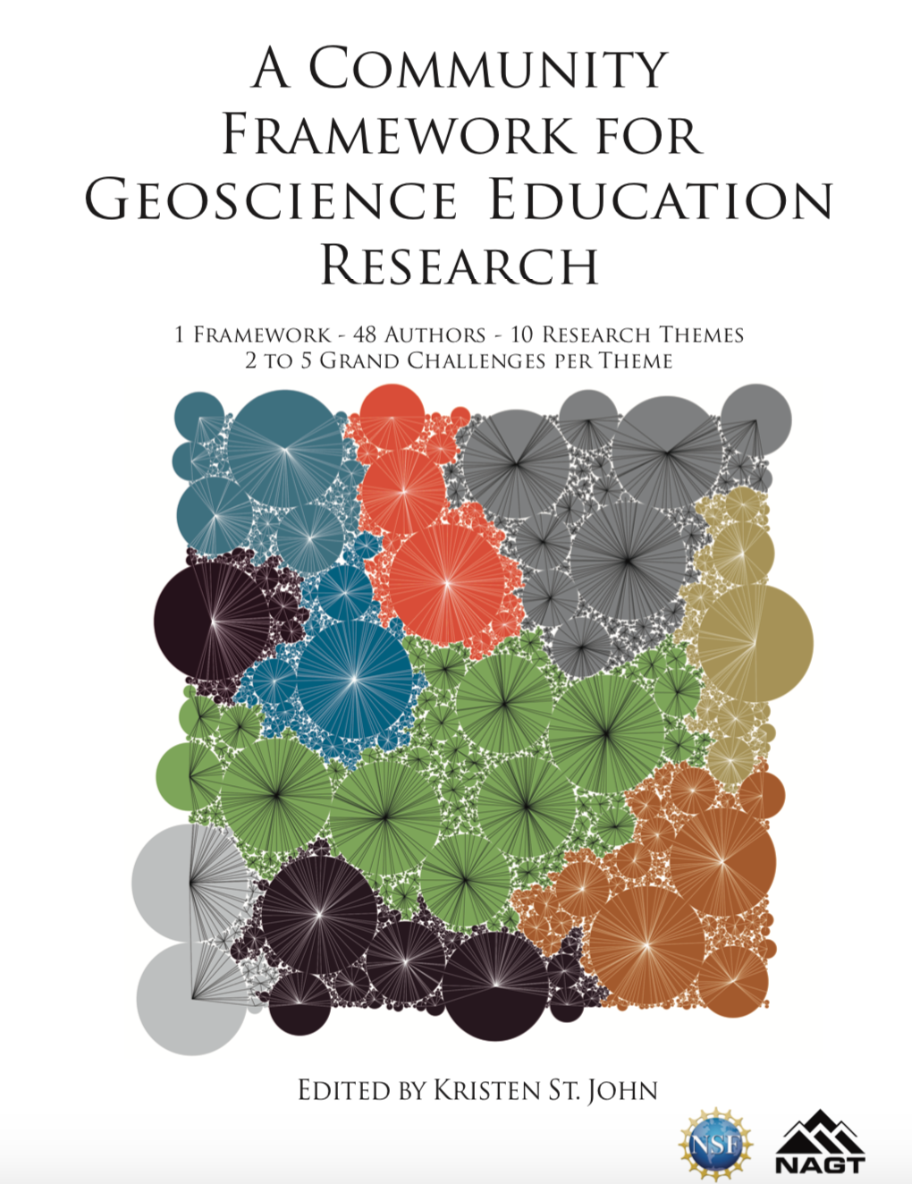
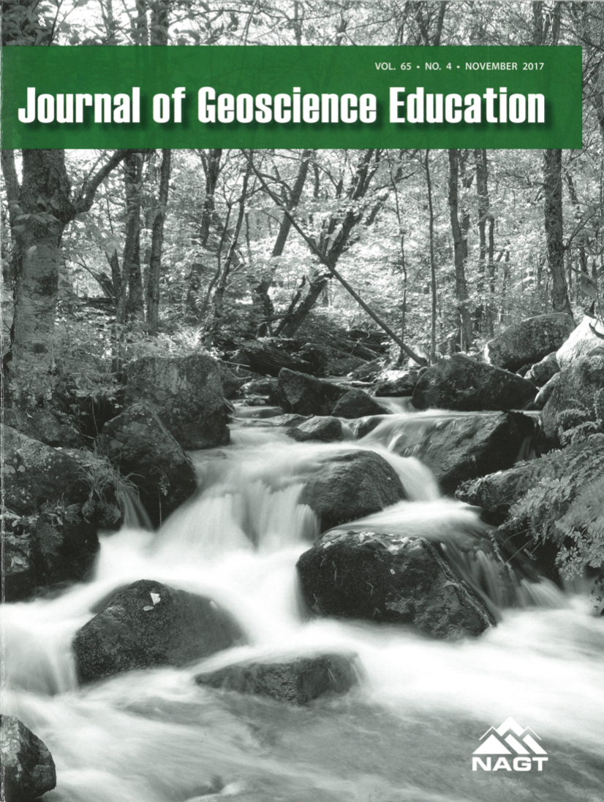
Identity in Geoscience Education Research
As envisioned in A Community Framework for Geoscience Education Research (St. John (Ed.), 2018)
As framed in recent issues of the
Journal of Geoscience Education
(2017; 2019)

Slide 4
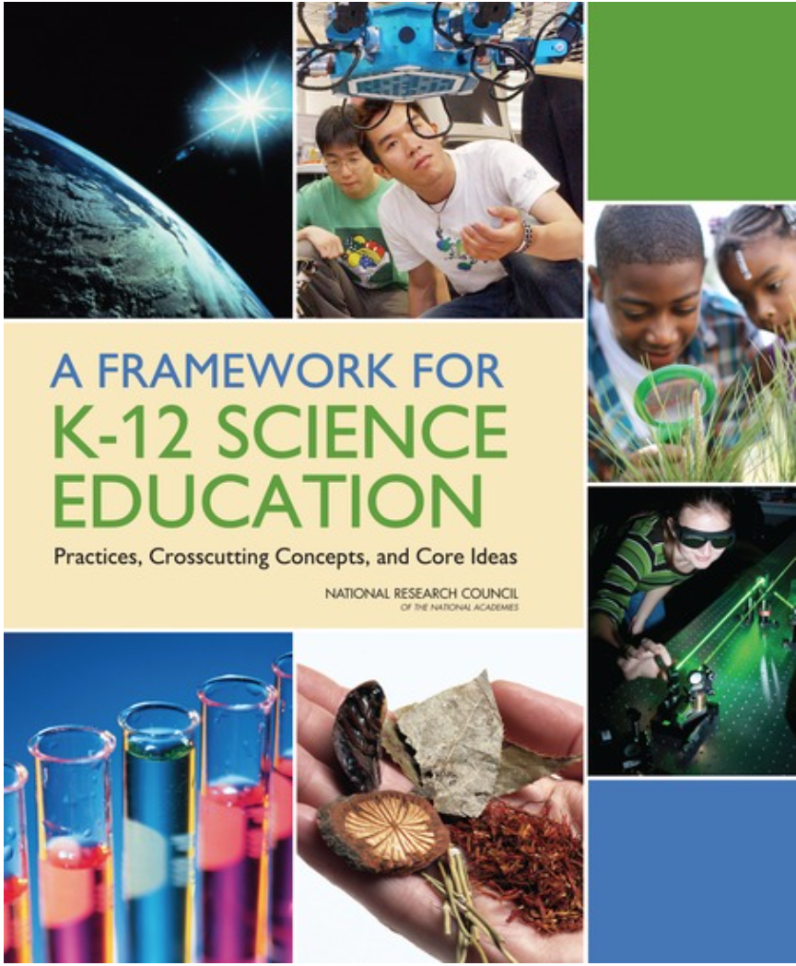

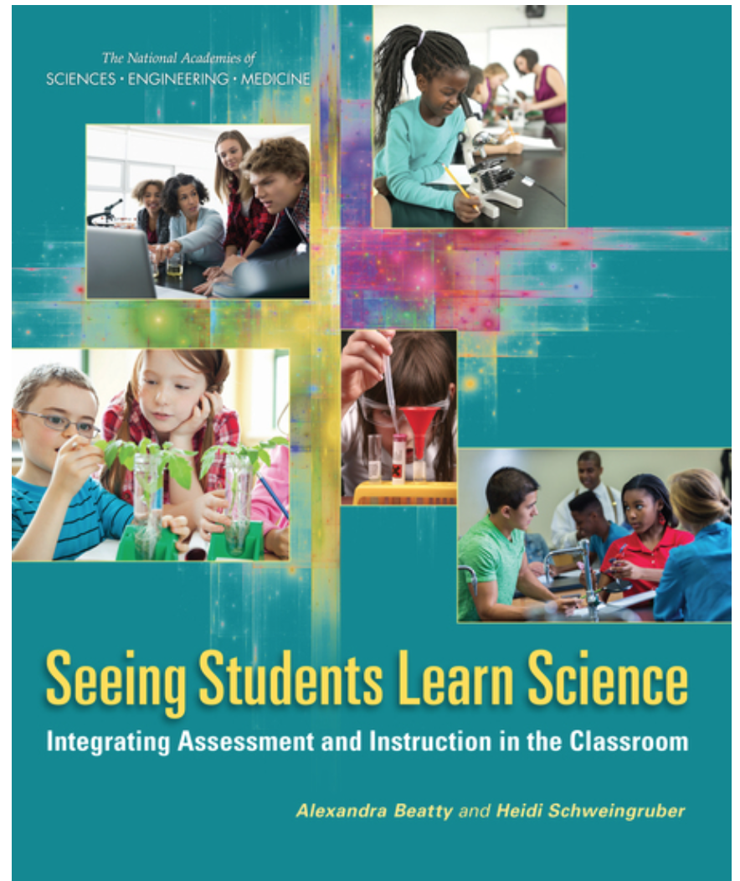

Beyond the 3 Dimensions
(NRC, 2012; Achieve, 2019; Institute for Science + Math Education, 2019; NASEM, 2017; OpenSciEd, 2019)

Slide 5
How can students’ identities be elicited, recognized, and leveraged in order to advance inclusivity?

Slide 6
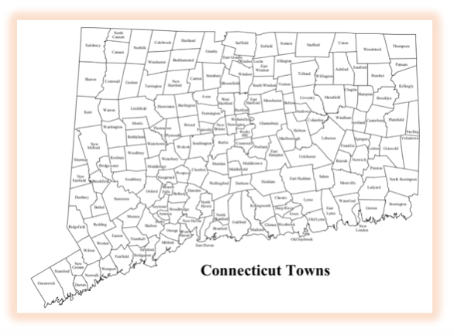
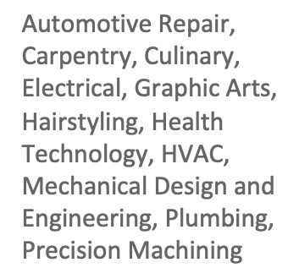





Characteristics of student population
Communities (23): College and Career Readiness
Rural, Suburban, Urban
(CSDE, 2019)

Slide 7
Situated Learning Theory
(Lave and Wenger, 1991; Brickhouse & Potter, 2001)

Slide 8
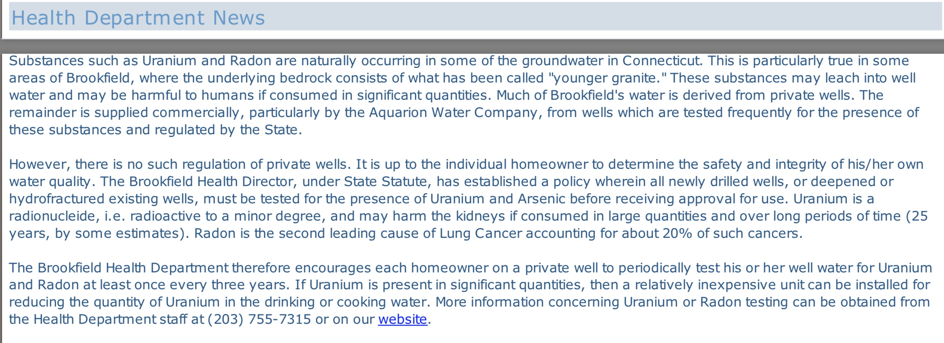
Why do some areas of Connecticut have radioactive groundwater?
(Town of Brookfield, 2016)

Slide 9
Science Identity Theory
(Carlone & Johnson, 2007; Nunez, et al., 2020; Camacho, et al., 2021)

Slide 10
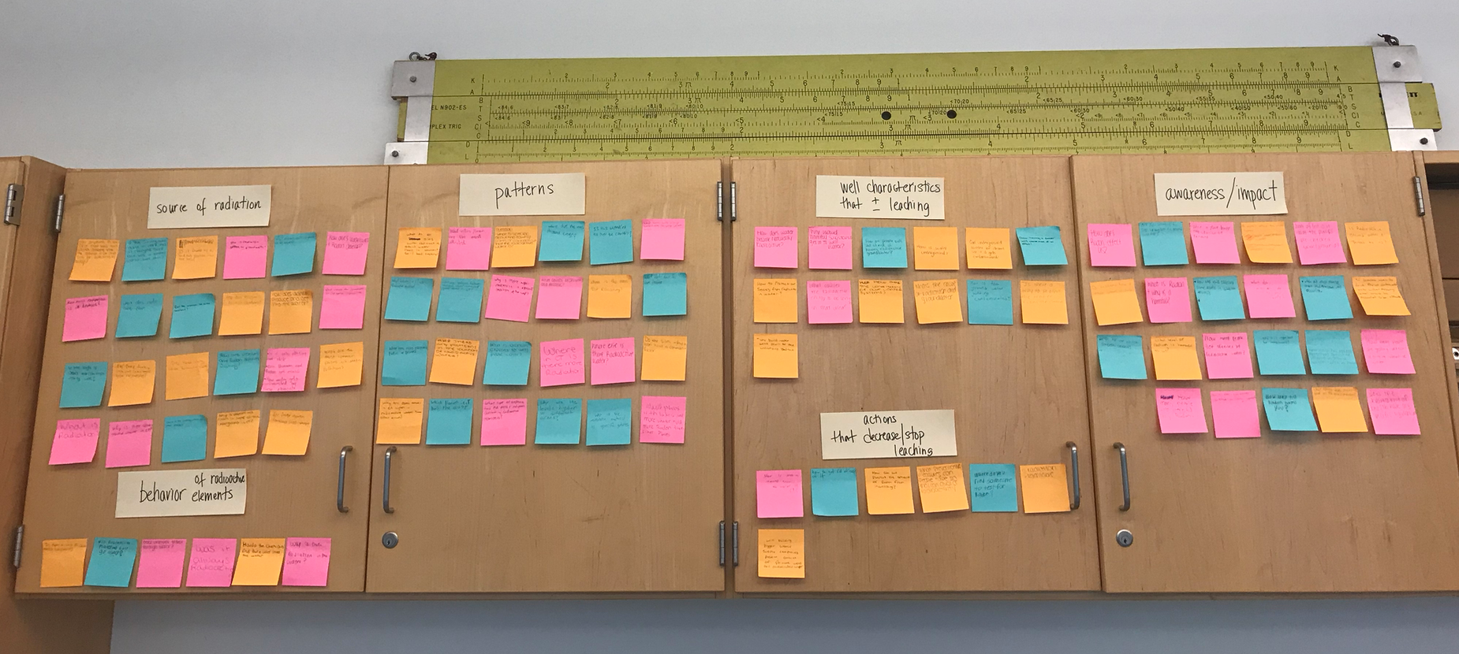
Many questions about radiation – source, amount, patterns, behavior, well characteristics, health impacts, mitigation strategies
(HATS Class of 2020, 2018)

Slide 11
Social Identity Theory
(Tajfel, 1981)

Slide 12
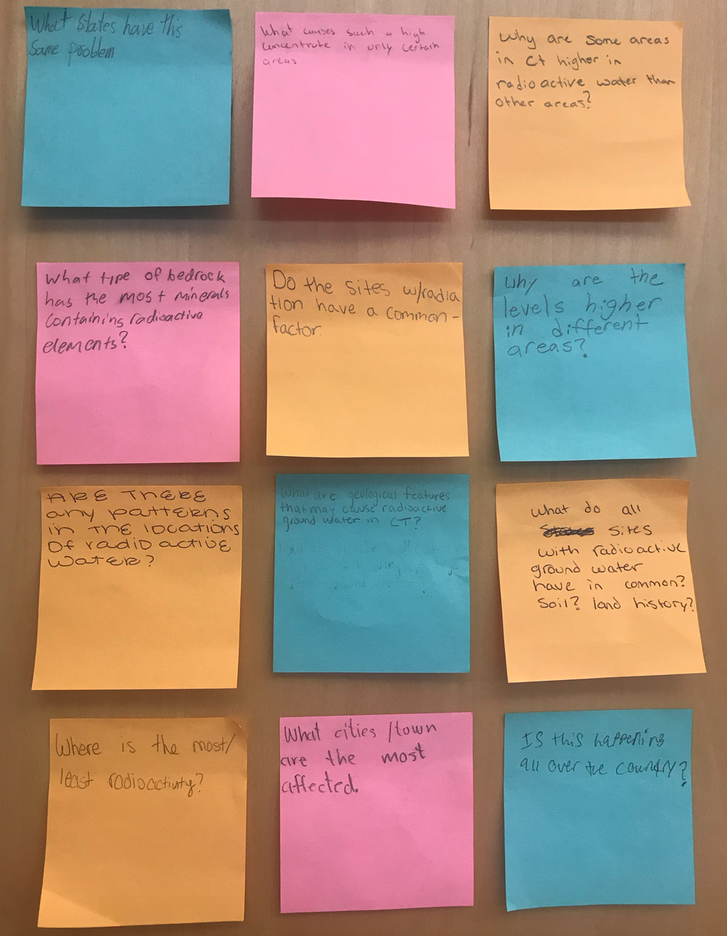
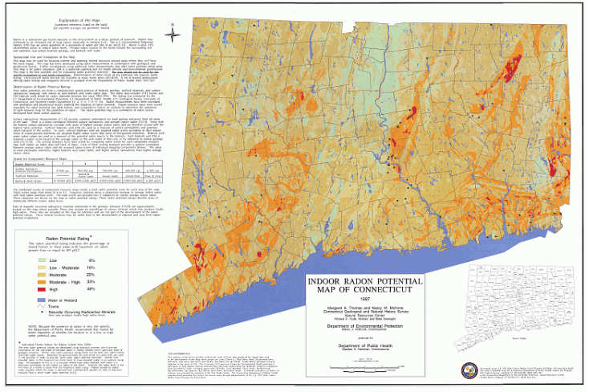
What patterns/relationships may help predict that a home may have radioactive well water?
(HATS Class of 2020, 2018; Thomas et al.,1997)

Slide 13
Third Space Theory
(Bhaba, 1994; Soja, 1999)

Slide 14
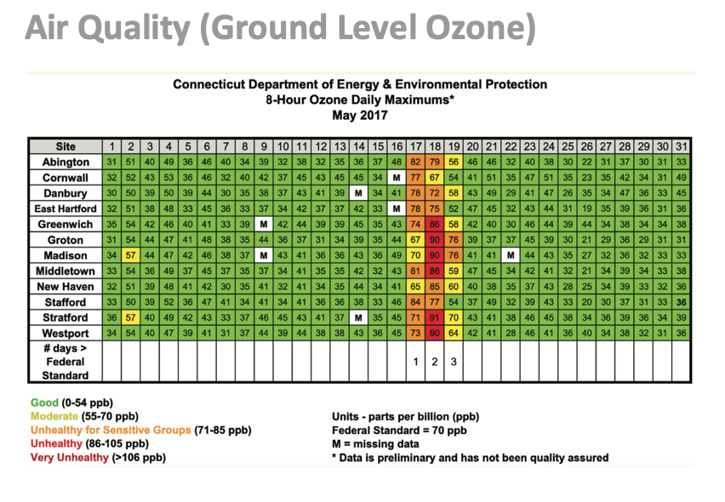

Slide 15
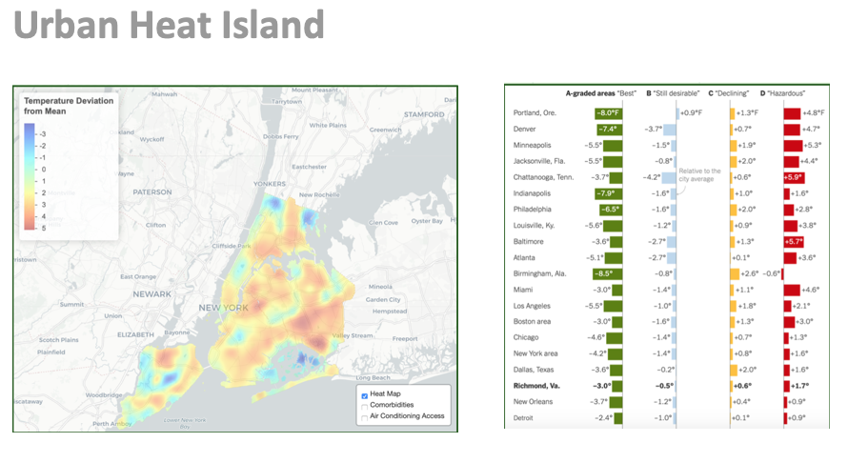
New York City Council, 2021
Popover & Popovich, 2020

Slide 16
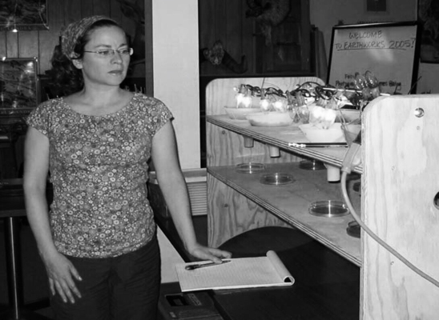
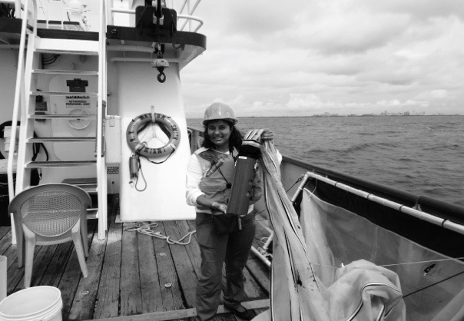
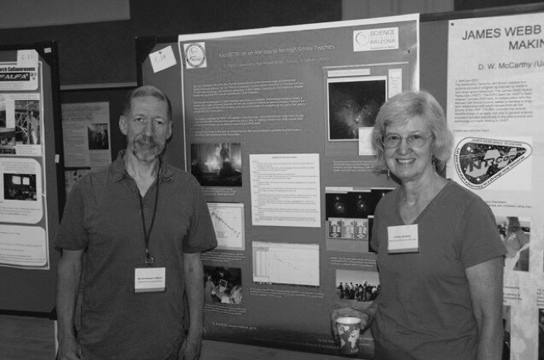
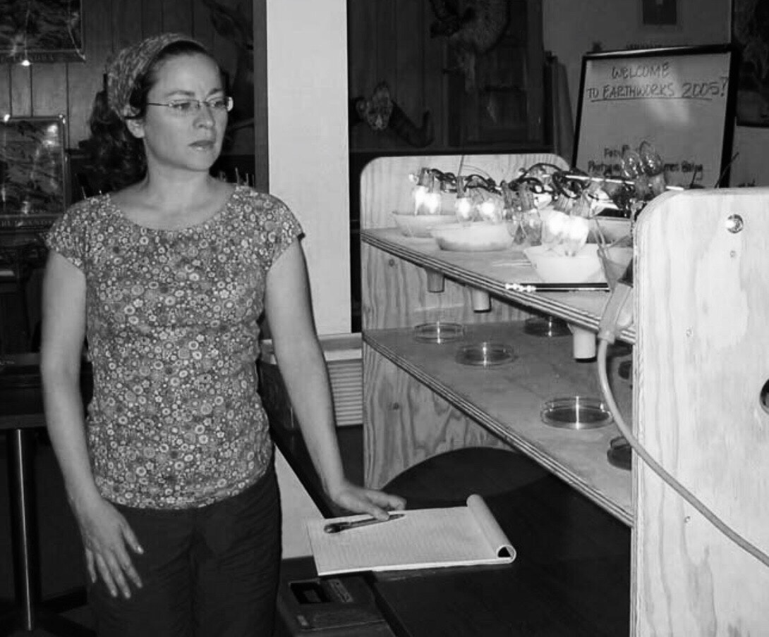
Envisioning an Inclusive
Geoscience Ecosystem
Susan Meabh Kelly
New York City Department of Education
CIRES Earthworks (2005)
Bhavna Rhawal
Houston Independent School District
NOAA Teacher at Sea (2012)
Chris Martin and Katy Garmany
Tucson Unified School District
NOAO AstroBits (2010)

Slide 17
Relevant Concerns
Efficient and Effective Use of Federal STEM Funds (Mervis, 2013; White House, 2014)
K-12 Use of Education Research (Penuel et al., 2017; Schneider, 2018)
Broader Impacts (ARIS, 2020; NSF, 2021)
Diversity, Equity, and Inclusion in STEM (NRC, 2012; Bernard & Cooperdock, 2018; NCSCS, 2019)
Fostering STEM Ecosystems (White House, 2018; NASEM, 2021)

Slide 18


Slide 19
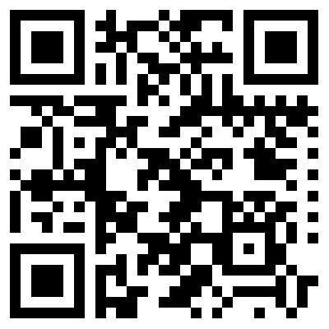
Susan Meabh Kelly susan.kelly@uconn.edu
Class of 2020 and 2022 at
Henry Abbott Technical High School
Danbury, Connecticut www.sciencepluseducation.com

Slide 20
References and Resources
Achieve (2019). Next Generation Science Standards. Retrieved from: https://www.achieve.org/next-generation-science-standards
Achieve (2019). Task Annotation Project in Science. Retrieved from: https://www.achieve.org/our-initiatives/equip/tools-subject/science/task- annotation-project-science.
Advancing Research Impact in Society (2020). Guiding principles. Retrieved from: https://researchinsociety.org/resource/guiding-principles-2/
Awad, A., Robeck, E., McCauliffe, C., Sullivan, S., & McDaris, D. (2017, October 12). STEM Teaching Tools: Resources for equitable science teaching and learning [Webinar]. In NAGT professional development Implementing the NGSS webinar series. Retrieved https://nagt.org/nagt/profdev/workshops/ngss_summit/stem_teaching/index.html
Bernard, R., & Cooperdock, E. (2018). No progress on diversity in 40 years. Nature Geosciences, 11, 292-295.
Brickhouse, N & Potter, J. (2001). Young women’s scientific identity formation in an urban context. Journal of Research in Science Teaching, 38: 965-980.

Slide 21
Callahan, C. N., LaDue, N. D., Baber, L. D., Sexton, J., van der Hoeven Kraft, K. J., & Zamani-
Gallaher, E. M. (2017). Theoretical perspectives on increasing recruitment and retention of underrepresented students in the geosciences. Journal of Geoscience Education, 65(4), 563-576
Callahan, C. N., Libarkin, J. C., McCalllum, C. M., & Atchison, C. L. (2015). Using the lens of social capital to understand diversity in the Earth system sciences workforce. Journal of Geoscience Education, 63(2), 98-104.
Camacho, T., Vasquez-Salgado, Y., Chavira, G., Boyns, D., Appelrouth, S., Saetermore, C., Khachikian (2021). Science identity among Latinx students in the biomedical sciences: The role of a Critical Race Theory-informed undergraduate research experience. CBE-Life Sciences Education.
Carlone, H. & Johnson, A. (2007). Understanding the science experiences of women of color: Science identity as an analytic lens. Journal of Research in Science Teaching.
Connecticut State Department of Education (2019). 2017-2018 profile and performance report: Henry Abbott Technical High School. Hartford, Connecticut: Connecticut State Department of Education. Retrieved from: http://edsight.ct.gov/SASPortal/main.do
Hurtado, S., Eagan, M., Cabrera, N., Lin, M., Park, J., & Lopez, M. (2008). Training future scientists: Predicting first-year minority student participation in health science research. Research in Higher Education, 49(2): 126-152.

Slide 22
Institute for Science + Math Education. (2019). STEM Teaching Tools. Retrieved from: http://stemteachingtools.org
Lave, J. & Wenger, E. (1991). Situated learning. Legitimate peripheral particicipation. Cambridge University Press.
Mervis, J. (2013). An invisible hand behind plan to realign U.S. science education. Science, 341, 338-341.
National Academies of Sciences, Engineering, and Medicine. (2017). Seeing Students Learn Science: Integrating Assessment and Instruction in the Classroom. Washington, DC: The National Academies Press.
National Academies of Sciences, Engineering, and Medicine. 2021. Call to Action for Science Education: Building Opportunity for the Future. Washington, DC: The National Academies Press
National Center for Science and Engineering Statistics (2019). Women, minorities, and persons with disabilities in science and engineering.
National Research Council. (2012). A Framework for K-12 Science Education: Practices, Crosscutting Concepts, and Core Ideas. Washington, DC: The National Academies Press.
National Science Foundation (2021). Proposal award policies & procedure guide. Retrieved from: https://www.nsf.gov/pubs/policydocs/pappg22_1/nsf22_1.pdf

Slide 23
NGSS Lead States. (2013). Next Generation Science Standards: For States, By States. Washington, DC: The National Academies Press.
New York City Council (2021). Heating and cooling equity. Retrieved from: https://council.nyc.gov/data/heat/
Nunez, A., Rivera, J., & Hallmark, T. (2020). Applying an intersectionality lens to expand equity in the geosciences. Journal of Geoscience Education, 68(2):97-114.
OpenSciEd. (2019). Features of classroom culture that support equitable eensemaking. Retrieved from: https://drive.google.com/file/d/1G7Ff9jS9zZMkCPML16Y4Na3Ncf2X7jks/view
Penuel, W., Briggs, D., Davidson, K., Herlihy, C., Sherer, D., Hill, H., Farrell, C., & Allen, A. (2017). How school and district leaders access, perceive, and use research. AERA Open.
Popover, B. and Popovich, N. (2020, August 24). How decades of racist housing policy left neighborhoods sweltering. New York Times. Retrieved from: https://www.nytimes.com/interactive/2020/08/24/climate/racism-redlining- cities-global-warming.html
Reiser, B.,, Novak, M., & McGill, T. (2017, June). Coherence from the students’ perspective: Why the vision of the Framework for K-12 Science requires more than “combining” three dimensions of science learning. Paper for Board on Science Education Workshop, Washington, D.C.

Slide 24
Schneider, (2018). How to make education research relevant to teachers. Retrieved from: https://ies.ed.gov/director/remarks/11-14-2018.asp
science + education collaboratory (2021). Retrieved from www.sciencepluseducation.com
St. John, K. (Ed.) (2018). A Community Framework for Geoscience Education Research. National Association of Geoscience Teachers. Retrieved from http://commons. lib.jmu.edu/ger_framework/15
Tajfel, H. (1981). Human groups and social categories. Cambridge University Press.
Thomas, M., McHone, N., Hyde, R., & Holbrook, S. (1997). Indoor radon potential map of Connecticut. Hartford, Connecticut: Department of Public Health. Retrieved from: https://www.ct.gov/deep/lib/deep/geology/radon/RadonPotential.pdf
Town of Brookfield (2016). Health department news. Brookfield Matters. Retrieved from: https://www.brookfieldct.gov/sites/brookfieldct/files/uploads/march_2016brookf ield_matters.pdf
Verdin, D. & Godwin, A. (2016). Systematic review of the funds of knowledge framework in STEM education. Paper presented at American Society for Engineering Education Conference, New Orleans.

Slide 25
Wertheim, J., Penuel, B., Smolek, T. J., Cooper, S., Krajcik, J., & Badrinarayan, A. (2019). Task Annotation Project: Introductory webinar [Webinar]. Retrieved from: https://zoom.us/recording/play/PGuFffWyKVa9a6teUb3ObQkUzKYqgySIYKyAXmu 1NtWHWiLQC5W42TDGcd3CGzq?continueMode=true
White House (2014). Progress report on coordinating federal science, technology, engineering, and mathematics (STEM) education.
White House (2018). Charting a course for success: America’s strategy for STEM education.

